Slide 1

USWDS Monthly Call
November 2022

Slide 2

Hi!
Thanks for being here!

Slide 3
Agenda
Product updates
User Profile Patterns, Part 2
Q&A

Slide 4
Product updates

Slide 5
USWDS 3.3.0
Inclusive patterns support

Slide 6
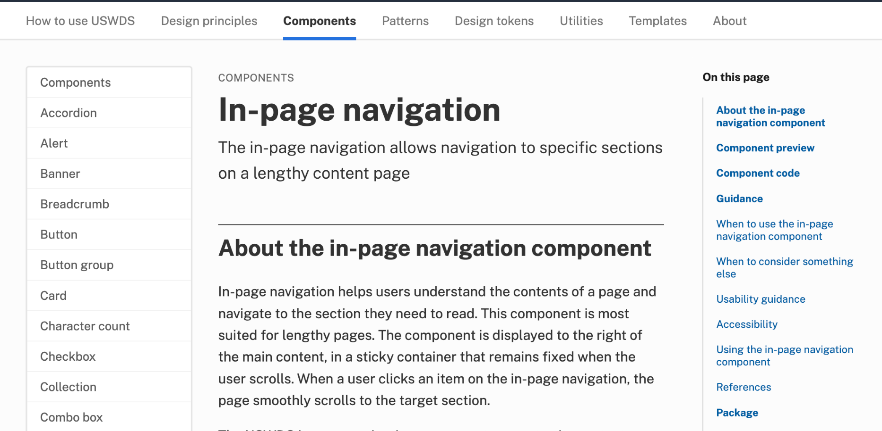
In-page navigation
designsystem.digital.gov/components/in-page-navigation

Slide 7
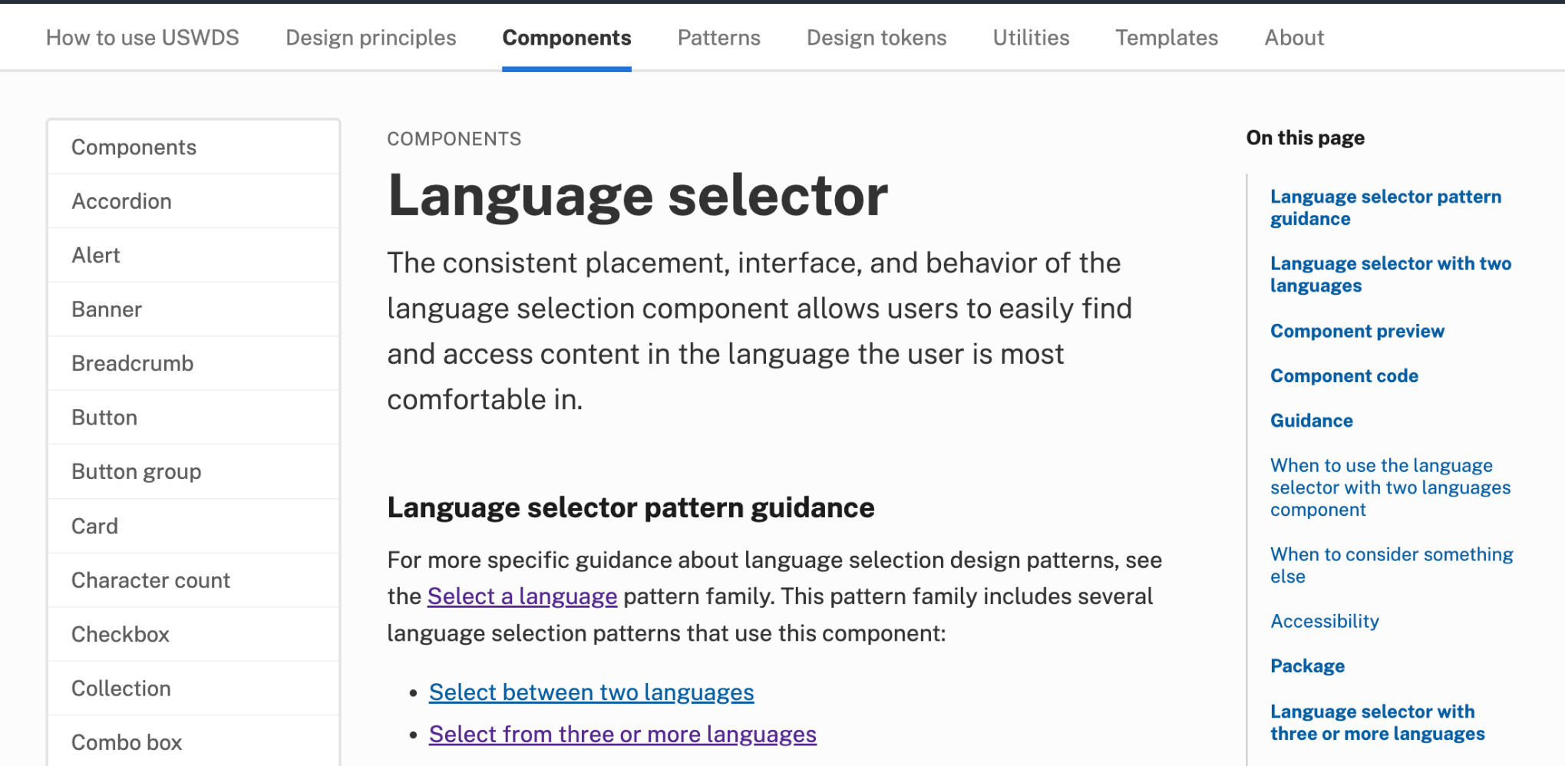
Language selector
designsystem.digital.gov/components/language-selector

Slide 8
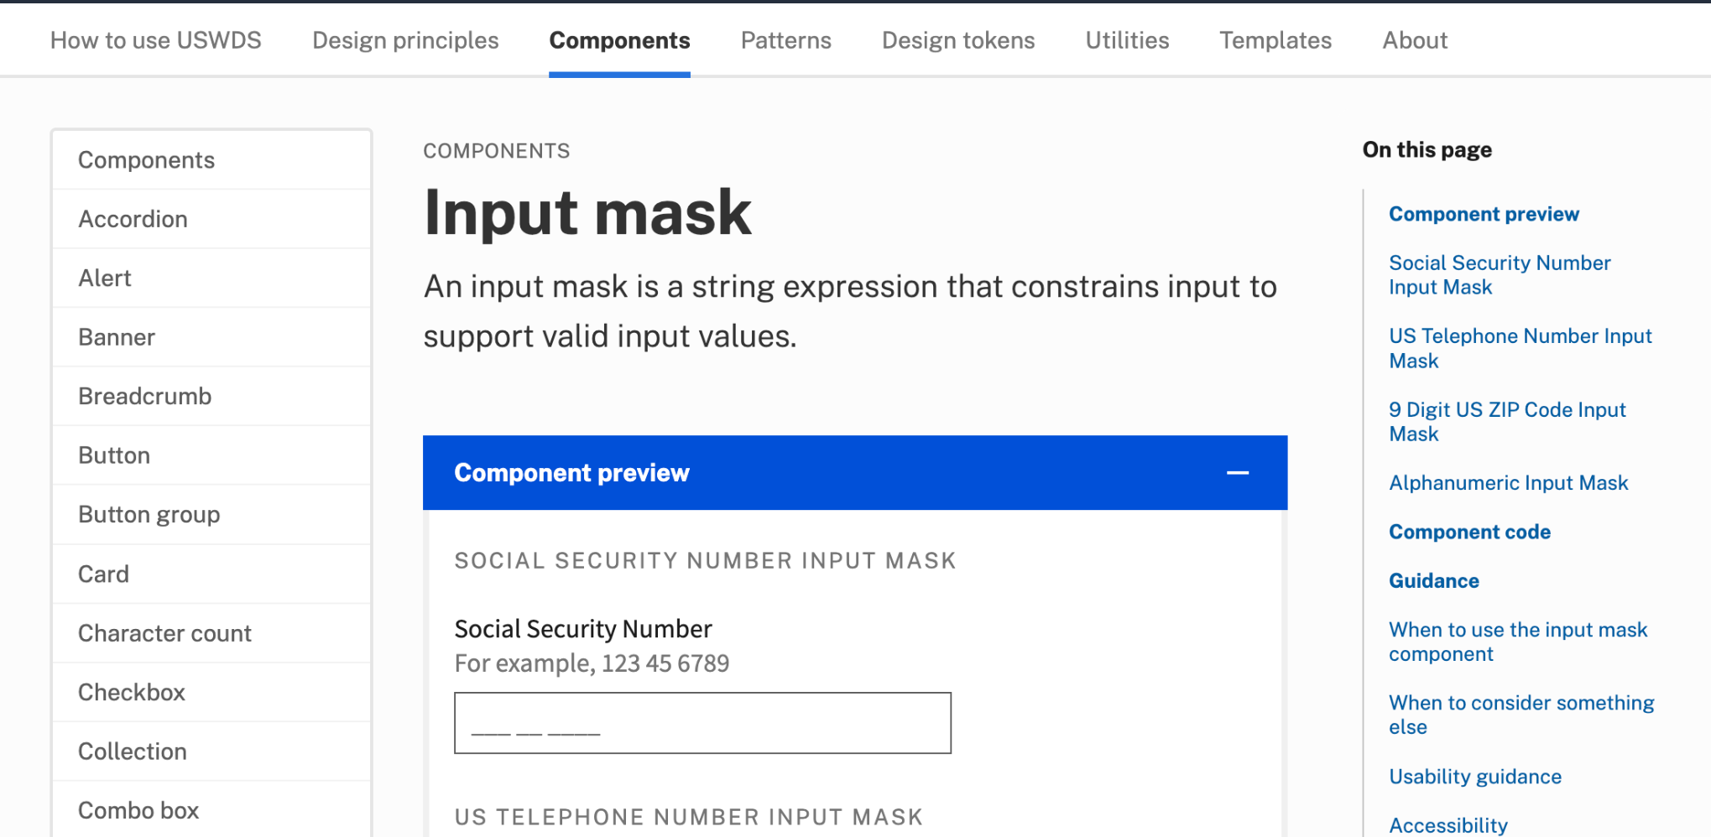
Input mask
designsystem.digital.gov/components/input-mask

Slide 9
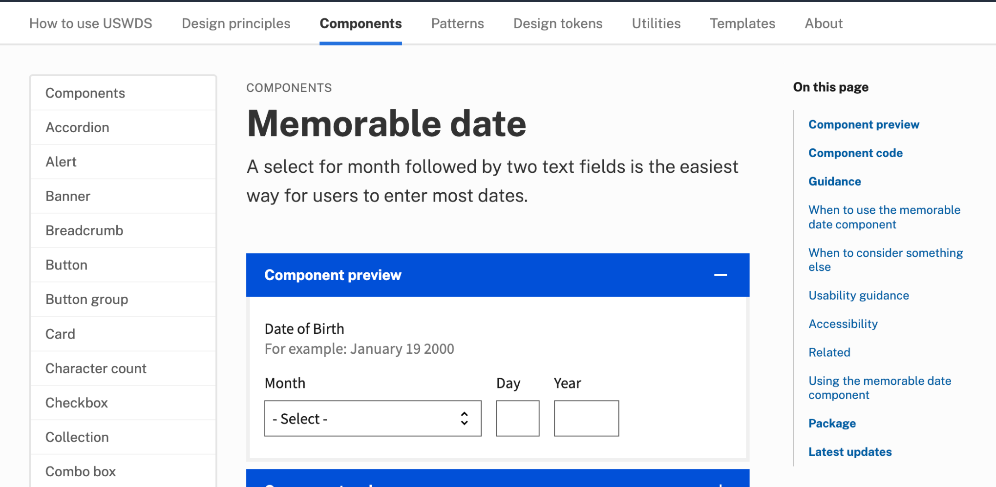
Update: Memorable date
designsystem.digital.gov/components/memorable-date

Slide 10
USWDS 3.3.0
Out now

Slide 11
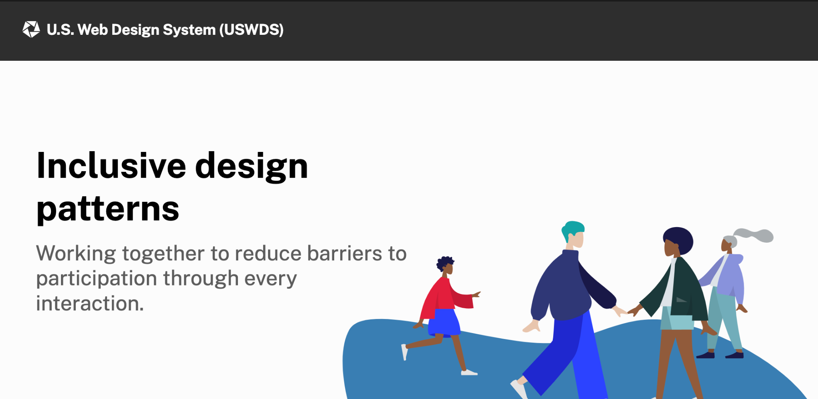
Together: An inclusive design report
designsystem.digital.gov/together

Slide 12
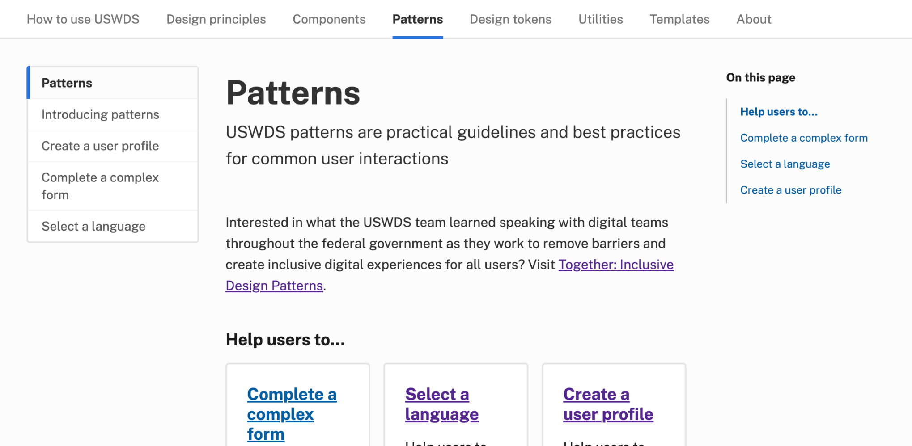
Pattern guidance
designsystem.digital.gov/patterns

Slide 13
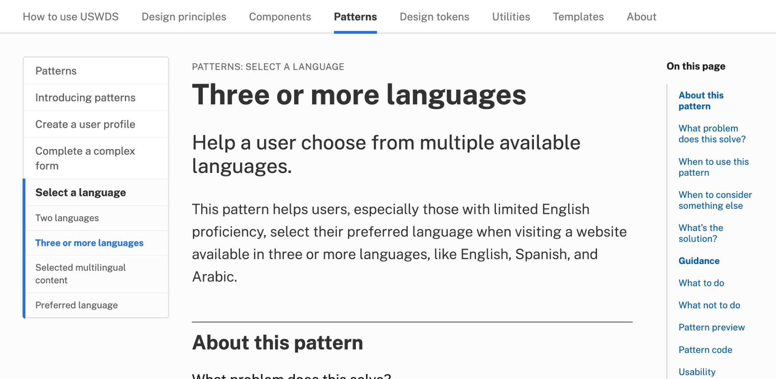
Pattern guidance: Language selection
designsystem.digital.gov/patterns/select-a-language/three-or-more-languages/

Slide 14
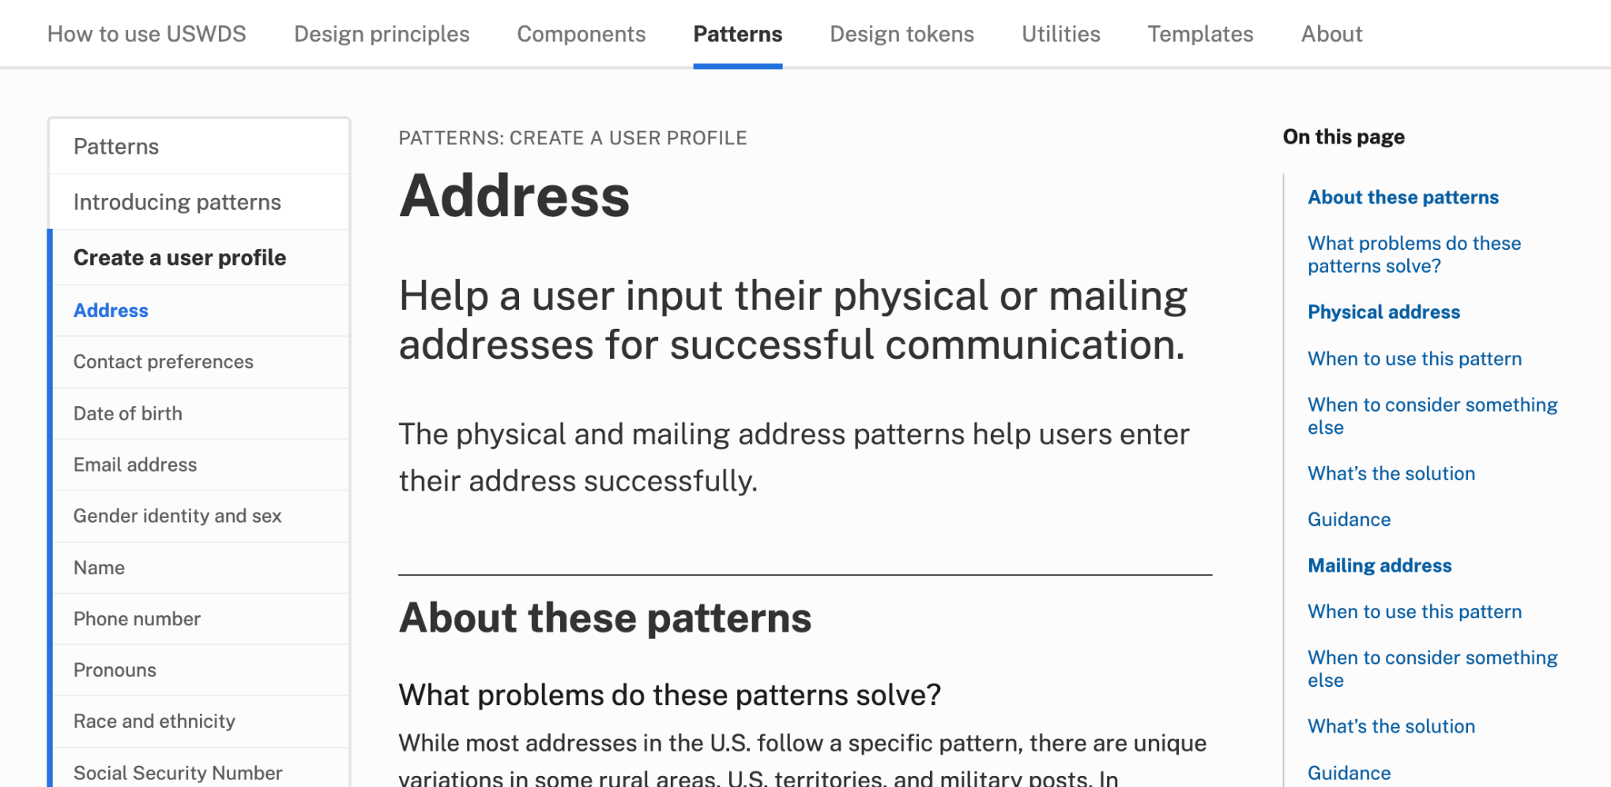
Pattern guidance: Address
designsystem.digital.gov/patterns/create-a-user-profile/address/

Slide 15
In-page navigation in action

Slide 16
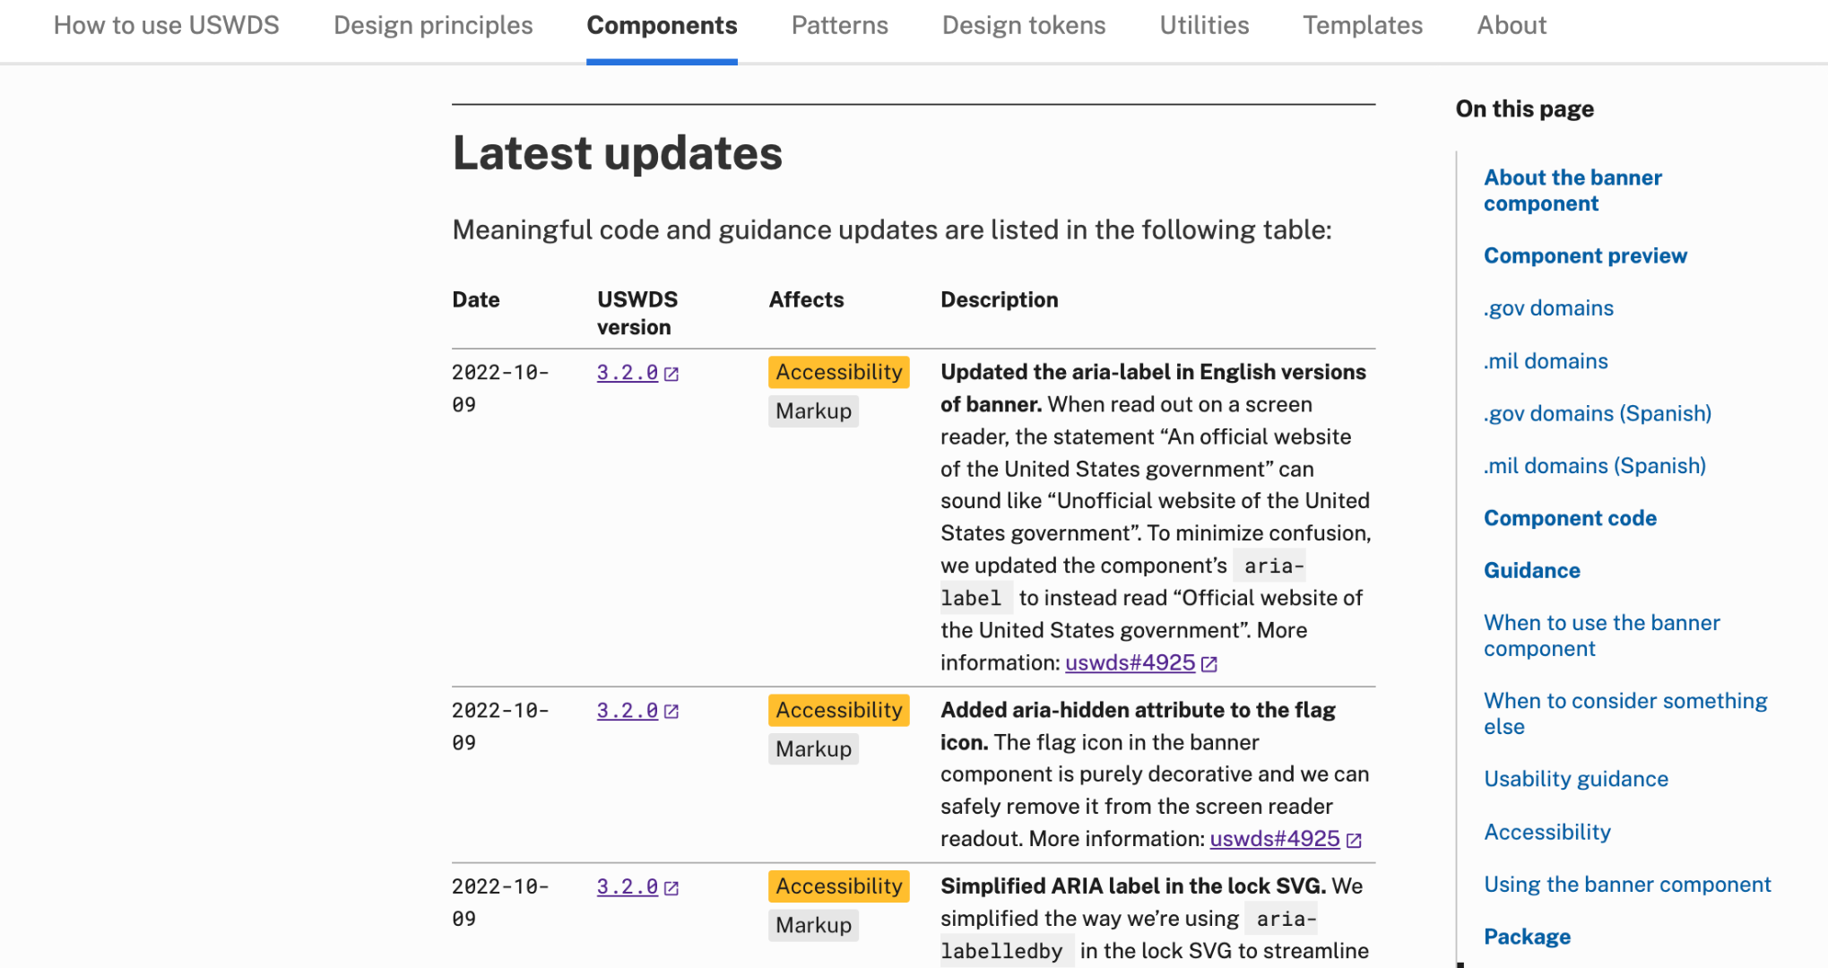
Latest updates
Changelogs for components, patterns, and guidance

Slide 17
Demo
Notes:
DW

Slide 18
The runway and the plane

Slide 19
Together

Slide 20
User Profile Patterns, Part 2 Personal information patterns

Slide 21
Meghan O’Meara
she/her
Content Strategist Inclusive Patterns
Contractor

Slide 22
Jona Decker
she/her
Technologist Inclusive Patterns
Contractor

Slide 23
Austin Hernandez
he/they
Sr. Product Designer 18F
Notes:
I am a masculine presenting, Mexican-American person with brown skin and shortish dark brown hair. I have freckles and a septum piercing and a blurred background.

Slide 24
Help a user to _________.
Notes:
DW

Slide 25
Reduce barriers to participation through every interaction
Notes:
DW

Slide 26
Relevant, clean data.
Good form design.
Inclusive experiences.
Notes:
AH: I started looking into inclusive form design as a passion project about a year ago for a few reasons. 1. I design a lot of government forms for projects I work on at 18F. Some forms have to meet certain guidelines, the form data needs to be actionable and relevant for the people reviewing it, so I want relevant, uniform, clean data 2. I’m a designer. I’ve looked at a ton of form patterns over my 15 year career. Forms need to be designed well, not only visually, but they need to be plain language, explanatory, feel safe, look good, not feel overwhelming, etc. And lastly, very personally. I was tired of my identity not being an option forcing me to choose inaccurate, arbitrary identifiers that are either inaccurate or downright offensive. And I’m not alone in this when I started asking people in my community who work with intake forms in healthcare and nonprofits, they shared similar challenges and frustrations—Not only in how to identify themselves, but being confused when certain questions were asked or what is the “right” way to ask

Slide 27
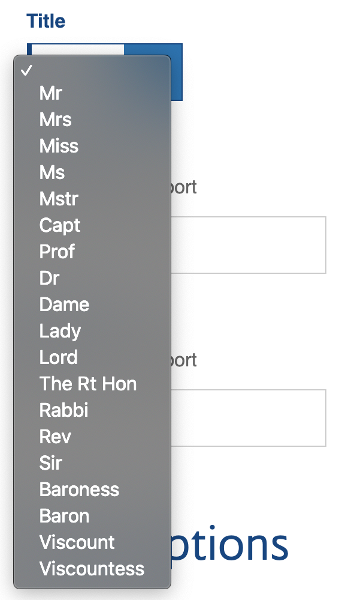
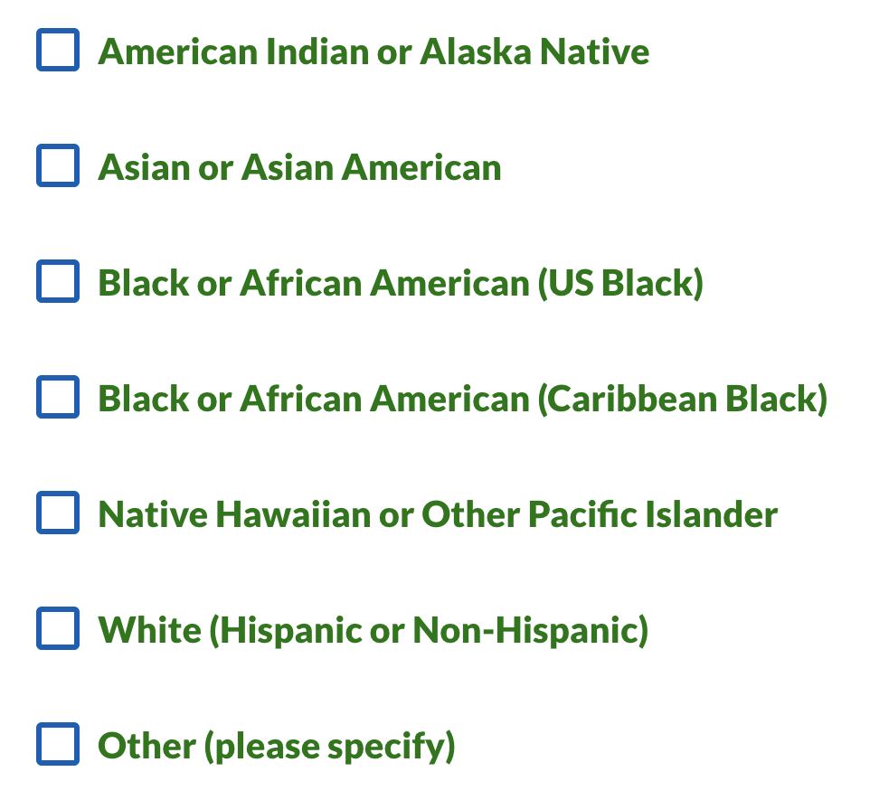
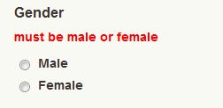
Three examples of exclusionary form design
Notes:
AH: This slide shows 3 examples of exclusionary form design. I run into tons of forms like these either at work or filling them out. From left to right. There’s a title or honorific dropdown with 19 options. 3 are asking if you are a wed or unwed woman. A few are if I'm maybe some kind of European royalty? And only professional titles like Rabbi or Dr. are gender neutral. The next form asks for my gender as either male or female, which excludes people with unspecified or other gender identities. Last, there’s a race and ethnicity form with 7 options. 2 checkboxes ask you to clarify if you are US Black or Carribean Black and the only option for Hispanic is White (Hispanic or non-Hispanic), so only “other” applies to me.
For many people I’m sure these work just fine. Maybe you are a Viscount American Indian male, but for others it’s not how we are seen by the world or how we see ourselves which is a bad user experience and makes the data less useful.
And now I’m going to turn it over to Jona to talk more about the Race and Ethnicity pattern.

Slide 28
Race and ethnicity
Notes:
DW

Slide 29
Race and ethnicity are often central to an individual’s sense of self
Notes:
DW

Slide 30
A social definition of race
Notes:
DW

Slide 31
Race: If you don’t need to know, don’t ask.
Notes:
DW

Slide 32
But sometimes you do need to know.
Notes:
DW

Slide 33
Racial categories provided by OMB
American Indian or Alaska Native
Asian
Black or African American
Native Hawaiian or Other Pacific Islander
White
Notes:
DW

Slide 34
People identify as multiple races
Notes:
DW

Slide 35
Ethnicity categories provided by OMB
Hispanic or Latino
Not Hispanic or Latino
Notes:
DW

Slide 36
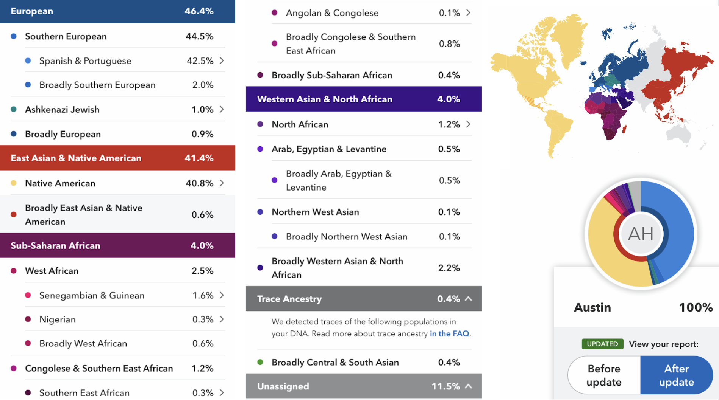
Genetic testing for ancestry results
Notes:
[AH] For sure. So because of this form dilemma, I decided to do DNA genetic testing for ancestry. The results were pretty much what I expected. They are also common results for people with brown skin that live in what is now known as the American Southwest and Central America. The chart on the screen shows that I’m 45% Spanish, 41% Native American, and the rest is from all over the huge, diverse continent of Africa.

Slide 37
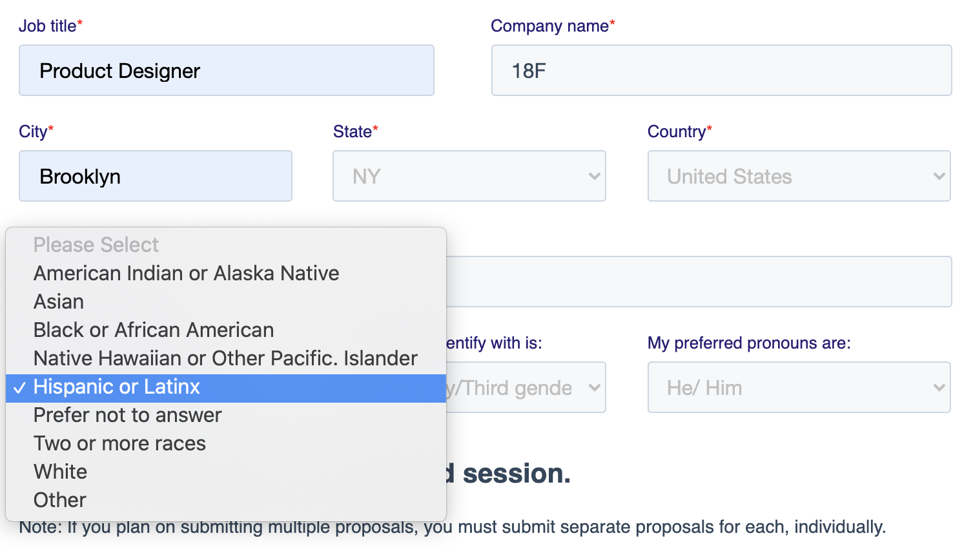
Choosing a single race and ethnicity from a dropdown
Notes:
However, forms rarely allow this answer for a few reasons. In this example, I have a screenshot of a form I tried to fill out within the last year. It uses a dropdown form pattern where I’m only allowed to choose 1 option from a dropdown for race AND ethnicity. I’m glad it has the gender inclusive Latinx option, but I have to choose between my racial identity or ethnic background.
Latino and Hispanic can be any race or racial combination and that’s something people miss a lot.

Slide 38
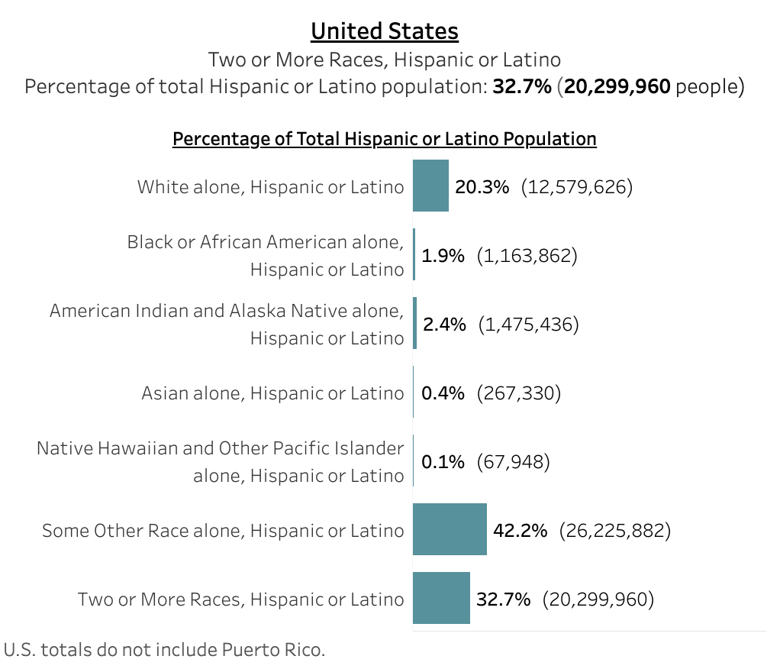
Census 2020 Hispanic and Latino race categorization
Notes:
As Jona was talking about 10% of the American population reporting multiple races. This screenshot shows Census 2020 data for people who identify as Hispanic or Latino. 42.2% selected that they were “some other race alone” and 32.7% chose “two or more races.” That’s a majority of the Hispanic and Latino ethnicity that are not represented here.

Slide 39
Race ≠ Ethnicity ≠ Nationality
Notes:
Race, ethnicity and nationality are all different things. Racially, I’m mostly half white Spanish and half Native American. Culturally and ethnically Hispanic. I was born in the US. My parents were all born in the US, my grandparents and great grandparents were all born in the US. That makes my nationality American.

Slide 40
Race is a social construct.
At best, it’s used to measure inequity and make positive change. At worst, it’s used for discrimination and harm.
Notes:
Race is a social construct. At best, it’s used to measure inequity and make positive change. At worst, it’s used for discrimination and harm.

Slide 41
Use meaningful categories for your program and allow self-identification
Notes:
As long as those are meaningful categories for your program, include those ethnicities in your form or allow users to self-identify. Then you can roll that information up into the larger OMB categories for reporting purposes.

Slide 42
OMB requires that race and ethnicity data map to their categories…
Race
American Indian or Alaska Native
Asian
Black or African American
Native Hawaiian or Other Pacific Islander
White
Ethnicity
Hispanic or Latino
Not Hispanic or Latino
Notes:
DW

Slide 43
OMB encourages you to collect more detailed race and ethnicity information, as long as it ladders up to these categories
Race
American Indian or Alaska Native
Asian
Black or African American
Native Hawaiian or Other Pacific Islander
White
Ethnicity
Hispanic or Latino
Not Hispanic or Latino
Notes:
DW

Slide 44
Do not separate race from ethnicity. Ask about them together.
Notes:
DW

Slide 45
Allow users to choose more than one race and ethnicity.
Notes:
DW

Slide 46
If possible, allow users to self-identify their ethnicity.
Notes:
DW

Slide 47
Always explain why.
Notes:
DW

Slide 48
Gender identity and sex
Notes:
DW

Slide 49
Gender is a social construct. At best, it’s used to measure inequity and make positive change. At worst, it’s used for discrimination and harm.
Notes:
[AH] Like race. Gender is a social construct. At best, it’s used to measure inequity and make positive change. At worst, it’s used for discrimination and harm.

Slide 50
Gender ≠ Sex ≠ Pronouns
Notes:
[AH] Also Gender ≠ Sex ≠ Pronouns. You can’t infer one from another. Your biology doesn’t have to match your appearance, the way you identify doesn’t have to match what others assume you are, and that also doesn’t have to do with the ways you want people to address you.

Slide 51
Many terms that describe
gender identities
have evolved over time.
Notes:
[AH] Terms change. Identities change. For example, trans activists of the 70s used the word transexual to identify themselves, but that word has fallen out of favor and it’s more acceptable to use the word transgender. There didn’t used to be an option for intersex, but advancements in medical research confirm there’s more nuance to biology than before.

Slide 52
Be inclusive. Be respectful. Listen for changes in terms and conventions.
Notes:
[AH] Look, this is such a complicated topic being distilled into one form field. It’s a deeply personal identity we are just now as a society coming to understand.
One person or one opinion from the LGBTQ+ community is not the unquestioned truth. USWDS isn’t the unquestioned truth. This is the best we have right now, and everything is iterative.
It’s important to be empathetic and listen but use guidance from communities that are more widely accepted. Even in non-web related instances, if you say the wrong thing, its ok to say “oops sorry, thanks for letting me know!”

Slide 53
Important to people’s identities
Notes:
[AH] The issue of gender is sometimes seen as a controversial and divisive issue because it’s becoming more mainstream. It doesn’t need to be.
These identities have been here, this whole time, it just wasn’t being counted or there was no language for it. This is just one visible sign of social change and progress. At one point women couldn’t vote, schools were racially segregated, interracial marriages were illegal, same-sex relations were a crime —and some of things are still true across the world.
But, several offices within the federal government, in academia, and in communities across the world are saying here are the ways people identify themselves, let’s count them!!

Slide 54
There are safety issues with asking for this information.
Notes:
[AH] But we need to ensure safety. Since this is a divisive topic right now, people don’t feel safe. Especially in a government context when there is so much legislation happening right now that directly impacts trans lives.
Many publicly available datasets will show you inequities in gender-based violence, income, and housing so it’s important data to have. However, if this data is needed, it’s important that privacy is protected or and separated from other personally identifiable information (PII).

Slide 55
This week is Transgender Awareness Week.
November 20 is Transgender Day of Rememberance.
Notes:
[AH] This week is transgender awareness week. The purpose is to bring attention to the community by educating the public about who transgender people are and advancing advocacy around issues of prejudice, discrimination, and violence that disproportiately affect the transgender community. And this coming Sunday is Transgender day of Rememberance, which started in the late 90s to draw attention to the continued violence against transgender people.

Slide 56
Gender identity and sex: If you don’t need to know, don’t ask.
Notes:
DW

Slide 57
Sex: Male, Female, X
Notes:
DW

Slide 58
Research is ongoing
Notes:
DW

Slide 59
Ask about sex and gender identity separately
Notes:
DW

Slide 60
Sex
Notes:
DW

Slide 61
Sex:
Clearly state why you need this information
Notes:
DW

Slide 62
Sex:
Provide only biological options
Notes:
DW

Slide 63
Sex:
Clearly state if this information needs to match a specific document
Notes:
DW

Slide 64
Sex:
Don’t include “Prefer not to answer”
Notes:
DW

Slide 65
Gender identity
Notes:
DW

Slide 66
Gender and gender identity
Notes:
DW

Slide 67
Gender identity:
Allow people to specify their gender identity in their own words
Notes:
DW

Slide 68
Gender identity:
Do include “Prefer not to answer”
Notes:
DW

Slide 69
Asking for
gender identity and sex
together

Slide 70
Pronouns
Notes:
DW

Slide 71
Pronouns are not the same as gender identity
Notes:
DW

Slide 72
Respect pronoun preference
Notes:
DW

Slide 73
Pronouns:
Allow people to enter pronouns in their own words
Notes:
DW

Slide 74
Pronouns:
Provide examples
Notes:
DW

Slide 75
Pronouns:
Don’t make pronouns mandatory
Notes:
DW

Slide 76
Pronouns:
Be prepared for complex answers
Notes:
DW

Slide 77
We’re grateful to our colleagues
Notes:
DW

Slide 78
Input from many teams and sources
Notes:
DW

Slide 79











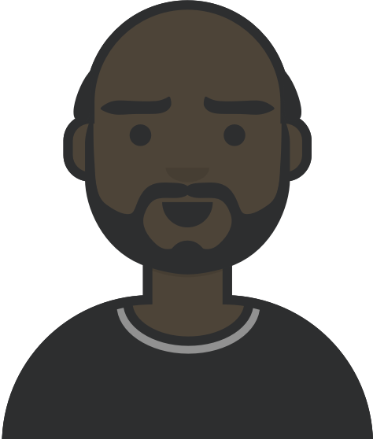
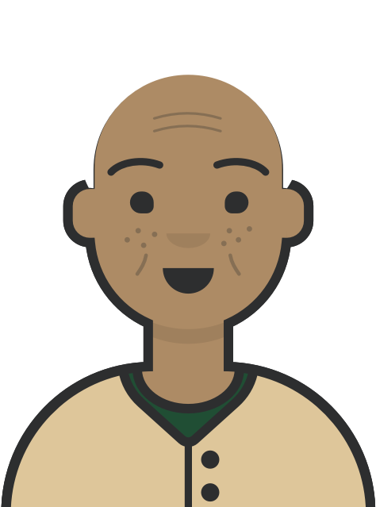






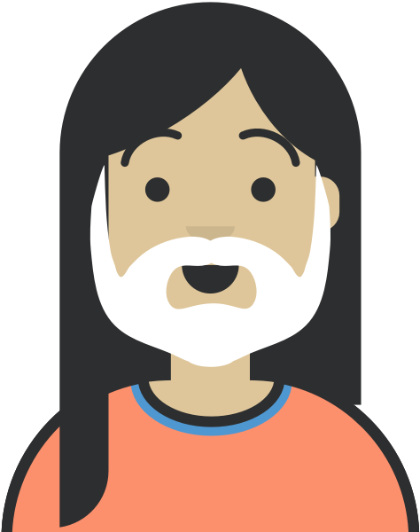


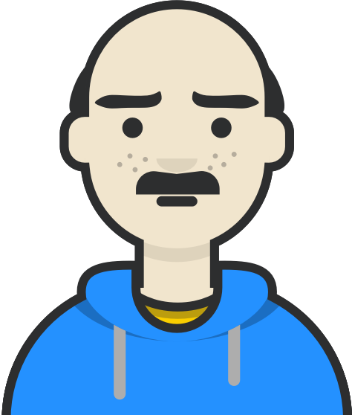







You know your audience.
Notes:
DW

Slide 80
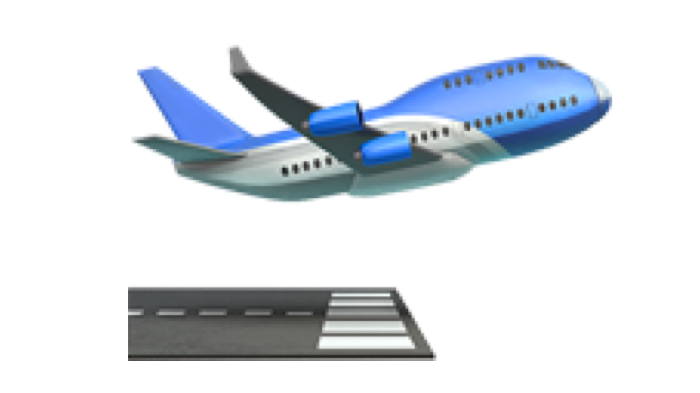
Take off!
Notes:
DW

Slide 81
Q&A
Notes:
DW

Slide 82
Next month
December: USWDS Year in Review
#uswds-public
github.com/uswds
designsystem.digital.gov
Notes:
DW

